Slide 1


Jasmine Framework for Java Script
SOFTWARE QUALITY | ASSURED

Slide 2

Jasmine – Open Source JavaScript Framework
Jasmine follows Behavior Driven Development(BDD) procedure to ensure that each line of java script statement is properly unit tested.
Why Use Jasmine
Jasmine does not depend on any other Java script Framework
Jasmine does not require DOM
Jasmine is heavily influenced by Rspec, JS Spec and Jspec
Jasmine is available in different versions like Stand-lone, ruby gem, Node.js etc
US | INDIA | CANADA | UK | AUSTRALIA | www.cigniti.com | Unsolicited Distribution is Restricted. Copyright © 2014, Cigniti Technologies
*

Slide 3
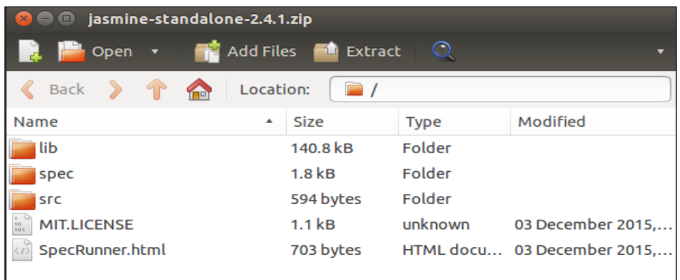
Jasmine Environment Setup
Download jasmine software from web site http://jasmine.github.io/
Once you download the jasmine, unzip the downloaded jasmine-standalone-2.4.1, you will the following strcture.
US | INDIA | CANADA | UK | AUSTRALIA | www.cigniti.com | Unsolicited Distribution is Restricted. Copyright © 2014, Cigniti Technologies
*

Slide 4
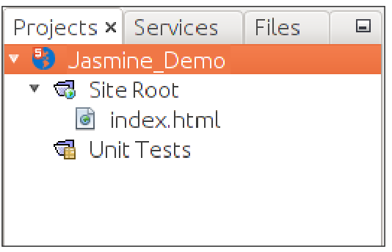
Jasmine - Writing Test & Execution
Step 1: Create a Web application in your IDE – NetBeans
In NetBeans, go to File --> New Project --> Html5/JS application and create a project. The project directory should look like the following image.
US | INDIA | CANADA | UK | AUSTRALIA | www.cigniti.com | Unsolicited Distribution is Restricted. Copyright © 2014, Cigniti Technologies
*

Slide 5
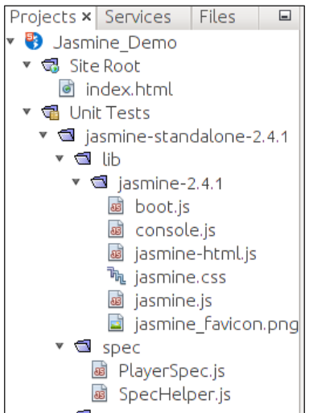
Jasmine - writing Test & Execution
Step 2: Include the Jasmine lib file into the application
After creating the project, include the unzip folder of jasmine library in the unit tests folder of the created application. After adding all the library files into the application, the structure of our project will look like as shown in the below image.
US | INDIA | CANADA | UK | AUSTRALIA | www.cigniti.com | Unsolicited Distribution is Restricted. Copyright © 2014, Cigniti Technologies
*

Slide 6
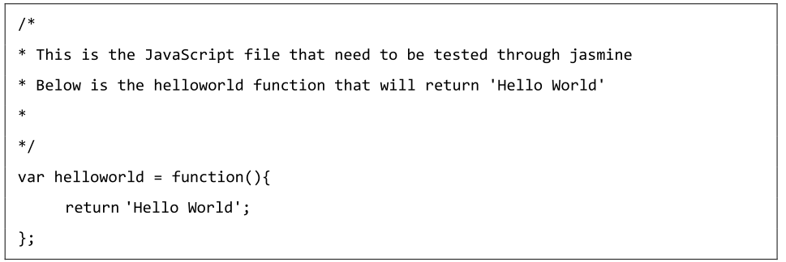
Jasmine - writing Test & Execution
Step 3: Create a Java Script file
Create a Java script file named helloworld.js under src folder. This is the file which we will test through jasmine.
US | INDIA | CANADA | UK | AUSTRALIA | www.cigniti.com | Unsolicited Distribution is Restricted. Copyright © 2014, Cigniti Technologies
*

Slide 7
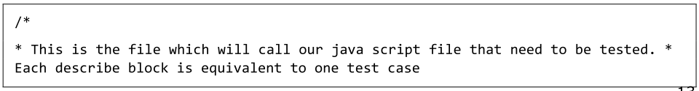
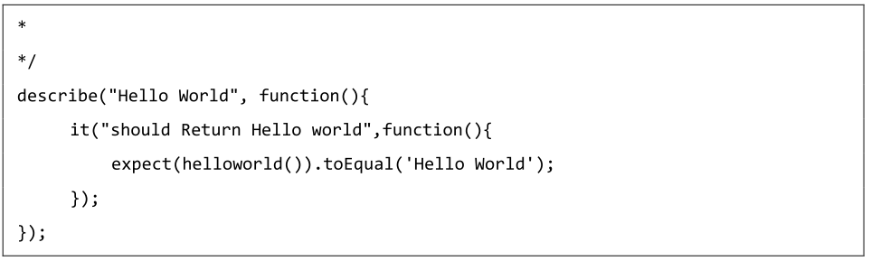
Jasmine - writing Test & Execution
Step 4: Create a Test case
Create a Java script file named helloworldSpec.js under 'Spec' folder.
US | INDIA | CANADA | UK | AUSTRALIA | www.cigniti.com | Unsolicited Distribution is Restricted. Copyright © 2014, Cigniti Technologies
*

Slide 8
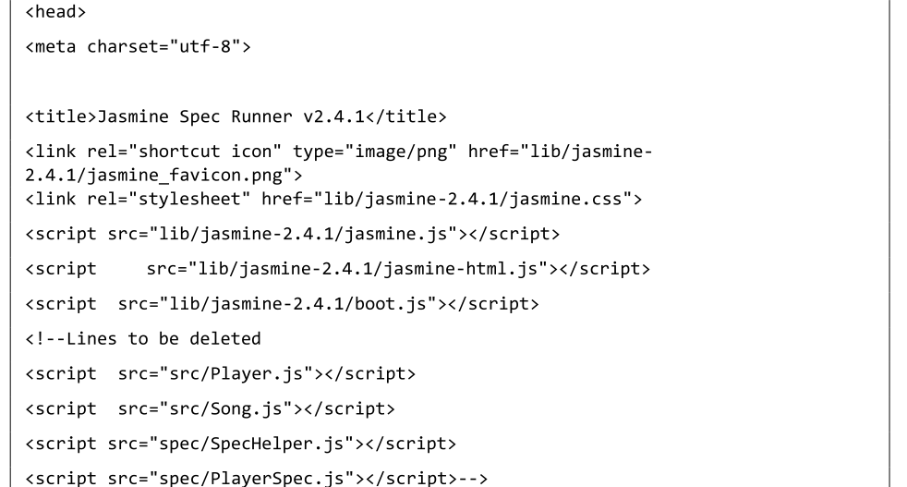
Jasmine - writing Test & Execution
Step 5: Add Reference to the output file
Create a Test Runner named "SpecRunner.html" and to include the reference of these two newly created file.
US | INDIA | CANADA | UK | AUSTRALIA | www.cigniti.com | Unsolicited Distribution is Restricted. Copyright © 2014, Cigniti Technologies
*

Slide 9
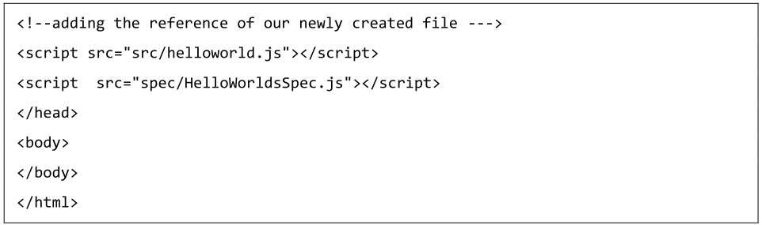
Jasmine - writing Test & Execution
US | INDIA | CANADA | UK | AUSTRALIA | www.cigniti.com | Unsolicited Distribution is Restricted. Copyright © 2014, Cigniti Technologies
*

Slide 10
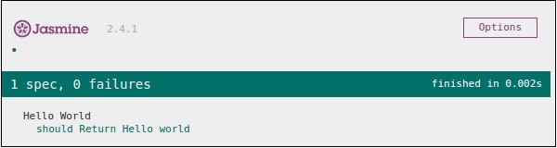
Jasmine - writing Test & Execution
Step 6: Execute by Running SpecRunner.html
Run SpecRunner.html in any of browser ,will appear as a result as below. The green screen indicates the success, whereas red indicates failure in test case.
US | INDIA | CANADA | UK | AUSTRALIA | www.cigniti.com | Unsolicited Distribution is Restricted. Copyright © 2014, Cigniti Technologies
*

Slide 11
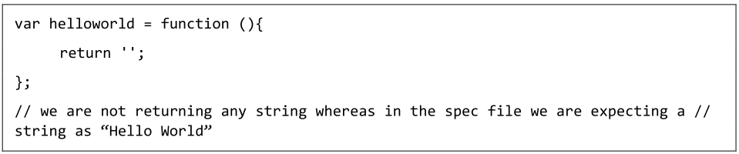
Jasmine - Writing Test & Execution
Step 7: Understand the Failure case
Till now we have seen the Success test case of the hello world application. Now let us see what if something goes wrong and the test fails. Modify the helloworld.js file using the following code.
US | INDIA | CANADA | UK | AUSTRALIA | www.cigniti.com | Unsolicited Distribution is Restricted. Copyright © 2014, Cigniti Technologies
*

Slide 12
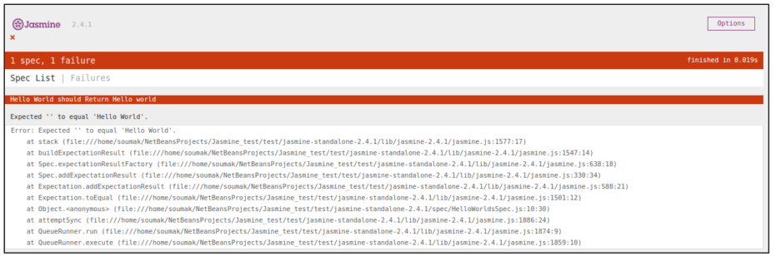
Jasmine - Writing Test & Execution
The above code is definitely going to fail because the 'Sepc' file is not getting the expected string as an output of the 'helloworld()'. The following screenshot of the "SpecRunner.html" file depicts that there is an error with its red indicator.
US | INDIA | CANADA | UK | AUSTRALIA | www.cigniti.com | Unsolicited Distribution is Restricted. Copyright © 2014, Cigniti Technologies
*

Slide 13
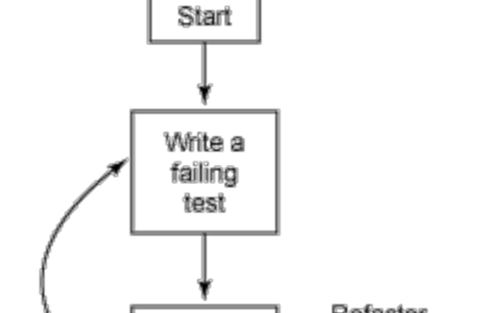
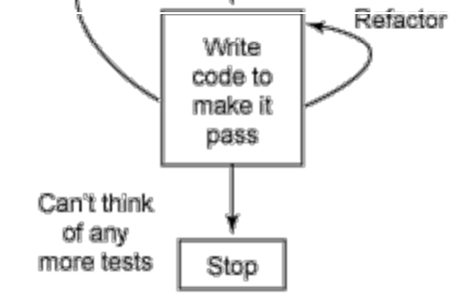
Jasmine – BDD Architecture
Jasmine follows the Behavioral Driven Development (BDD) framework. The following flow chat depicts the different phases of BDD framework.
US | INDIA | CANADA | UK | AUSTRALIA | www.cigniti.com | Unsolicited Distribution is Restricted. Copyright © 2014, Cigniti Technologies
*

Slide 14
Jasmine – BDD Architecture
Step 1: Start
In this phase, we will make our environment ready for jasmine application.
Step 2: Write a failing test
We will write first ever test case. It is obvious that tis test is going to fail because there is no such file or function to be tested.
Step 3: Write a code to make it pass
We will prepare java script file or function that needs to be tested. This phase is crucial as need to make sure that all the test cases prepared in the early stage will be successful.
US | INDIA | CANADA | UK | AUSTRALIA | www.cigniti.com | Unsolicited Distribution is Restricted. Copyright © 2014, Cigniti Technologies
*

Slide 15
Jasmine – BDD Architecture
Step 4: Refactor
Refactor is a very important phase of BDD model where we need to prepare as many test cases as we can for that particular application or function.
Step 5: Stop
If everything is going well then application must be ready and up. So we can consider this step as an end of the BDD application.
US | INDIA | CANADA | UK | AUSTRALIA | www.cigniti.com | Unsolicited Distribution is Restricted. Copyright © 2014, Cigniti Technologies
*

Slide 16
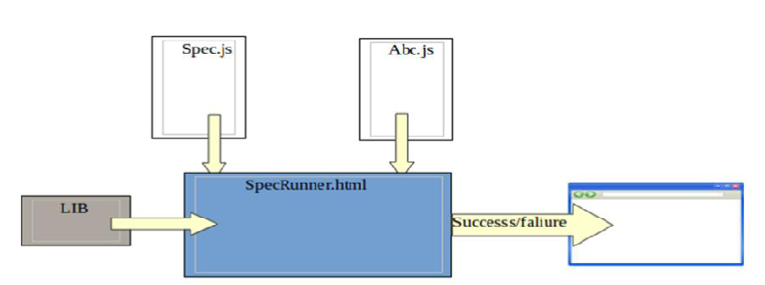
Jasmine BDD Framework Example
We have now gathered some knowledge about the working principle of BDD framework. Let us see how jasmine follows BDD in the line of java script testing.
As the screenshot depicts we need to test Abc.js using jasmine framework. SpecRunner.html is the output file that will take Spec.js(Test case file), Abc.js(file to be tested), LIB as an input and run all the test case present in the spec file and render the result into the browser.
US | INDIA | CANADA | UK | AUSTRALIA | www.cigniti.com | Unsolicited Distribution is Restricted. Copyright © 2014, Cigniti Technologies
*

Slide 17
Jasmine BDD Framework Example
Lib: these are the inbuilt java script files that will helpful to test different functions and other java script files used in our project.
Spec.js(Test case file): this is the java script file that contains all the test cases which is required to test any java script function or file. In BDD methodology, we are going to write the first test, hence this is the file that needs to be updated first. Definitely this is going to be fail as there is no such file or function present in our project that can be tested. this file can be refactored unlimited times until all the functionalities tested.
Abc.js(File to be tested): this is the file that contains your functionalities which will be unit tested using Spec.js and Lib file.
SpecRunner.html: this is a normal html file which will render the output of the unit test with the help of embedded java script codes in it.
US | INDIA | CANADA | UK | AUSTRALIA | www.cigniti.com | Unsolicited Distribution is Restricted. Copyright © 2014, Cigniti Technologies
*

Slide 18
Jasmine – Open Source Framework for Java Script
Thank you
US | INDIA | CANADA | UK | AUSTRALIA | www.cigniti.com | Unsolicited Distribution is Restricted. Copyright © 2014, Cigniti Technologies
*

